Slide 1
SVM
Marlabs

Slide 2
Table of Content
Support Vector Machine Definition
Basic Intuition Behind SVM (classification)
Margin
Nonlinear Hyperplane
Tune Parameters of SVM

Slide 3
Support Vector Machine
“Support Vector Machine” (SVM) is a supervised machine learning algorithm that analyze data and recognize patterns, used for classification and regression analysis.
Given a set of training samples, each marked for belonging to one of two categories, an SVM training algorithm builds a model that assigns new samples into one category or the other, making it a non-probabilistic binary linear classifier.
An SVM model is a representation of the examples as points in space, mapped so that the examples of the separate categories are divided by a clear gap that is as wide as possible.
New examples are then mapped into that same space and predicted to belong to a category based on which side of the gap they fall on.

Slide 4
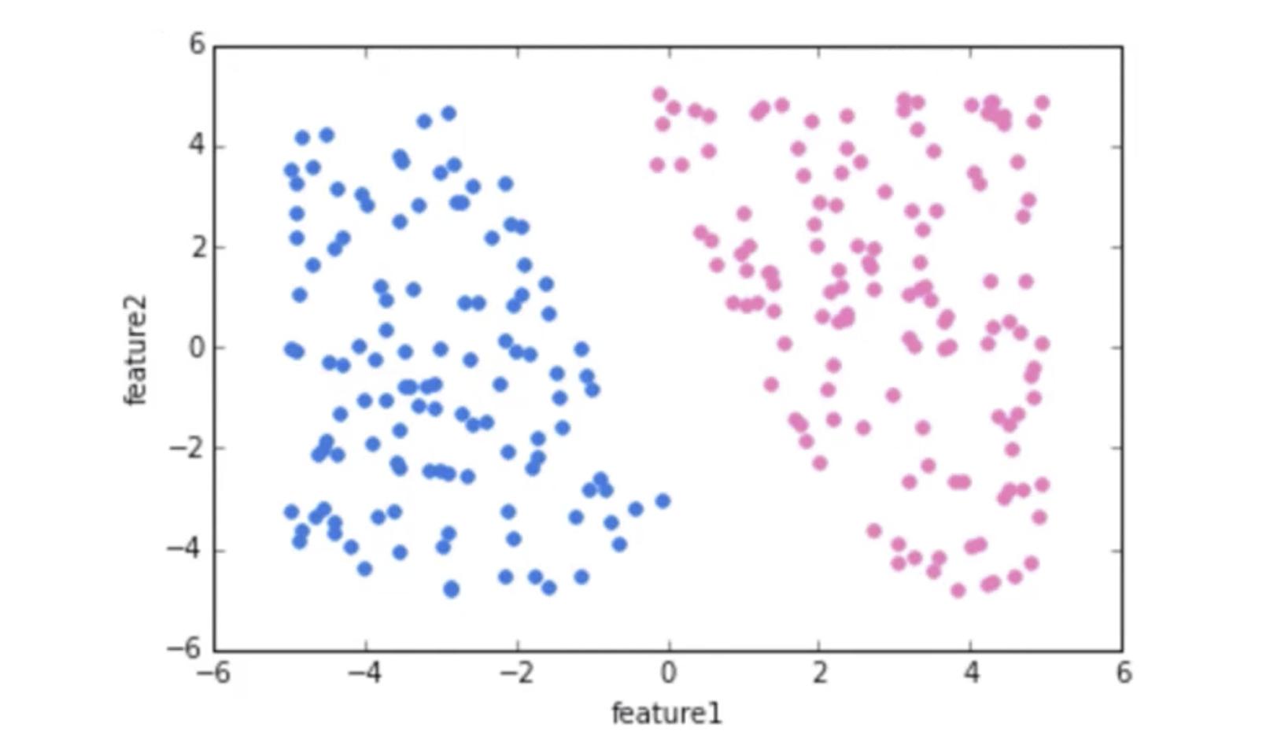
Basic Intuition Behind SVM
Imagine the labeled training data below:

Slide 5
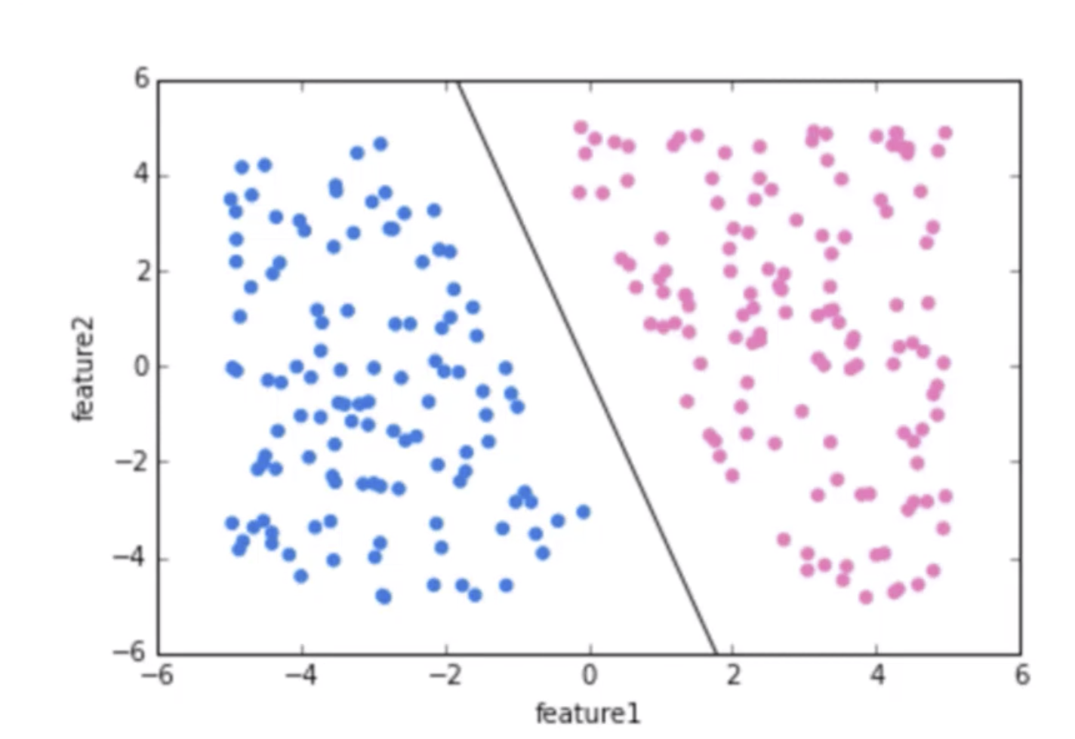
Basic Intuition Behind SVM
We can draw a separating “hyperplane” between the classes.

Slide 6
What is the Hyperplane?
A hyperplane is a line that splits the input variable space. In SVM, a hyperplane is selected to best separate the points in the input variable space by their class, either class 0 or class 1.

Slide 7
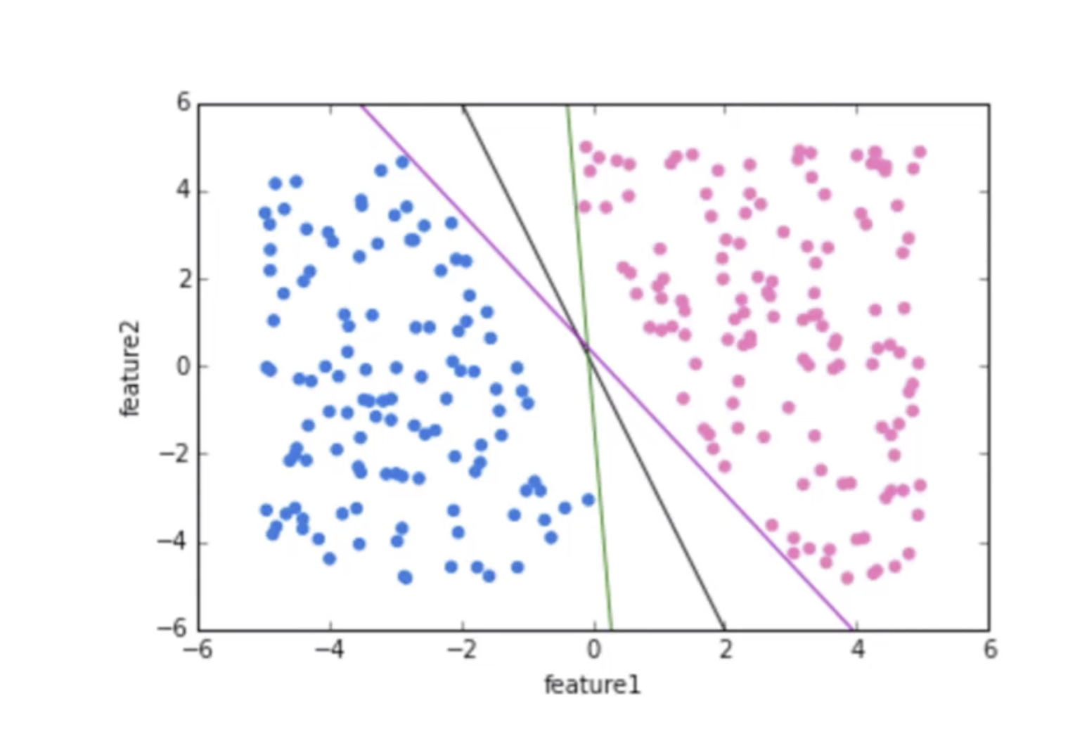
Basic Intuition Behind SVM
But we have many options of hyperplanes that separate perfectly.

Slide 8
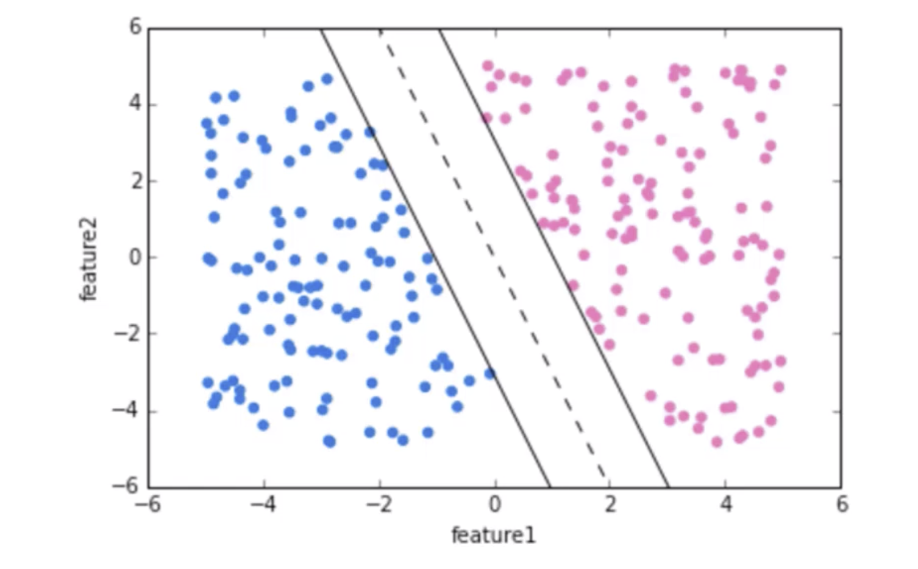
Basic Intuition Behind SVM
We would like to choose a hyperplane that maximizes the margin between classes.

Slide 9
What is the Margin?
The margin is calculated as the perpendicular distance from the line to only the closest points.

Slide 10
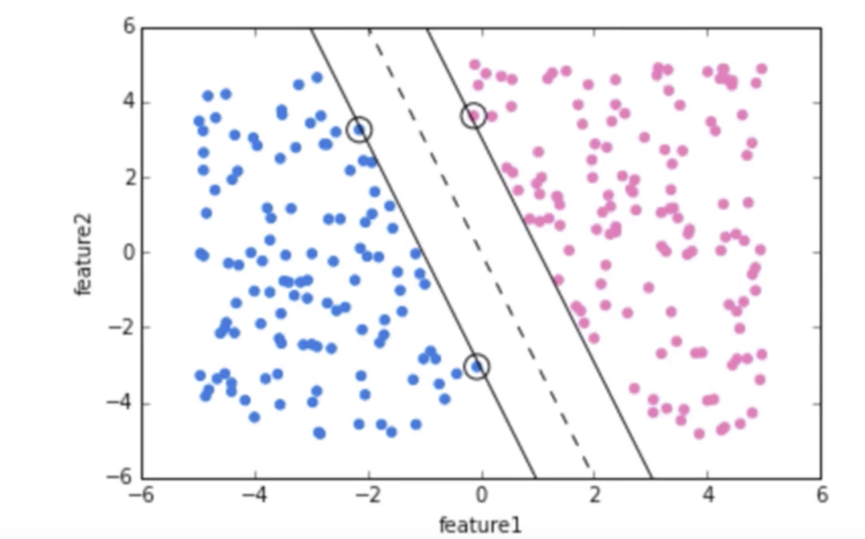
Basic Intuition Behind SVM
The vector points that the margin lines touch are known as Support Vectors.

Slide 11
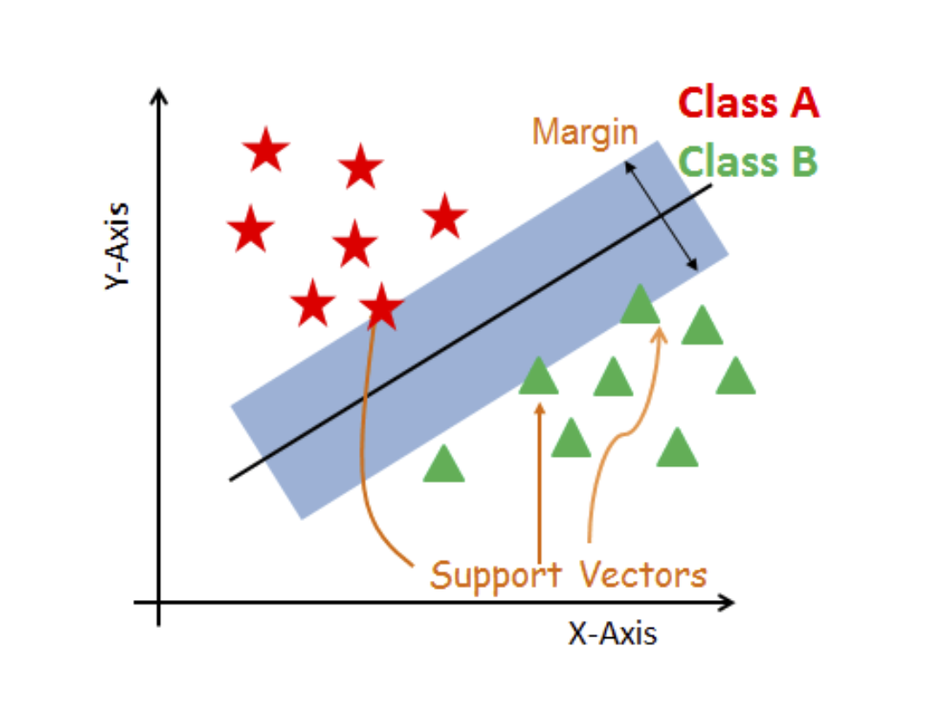

Slide 12
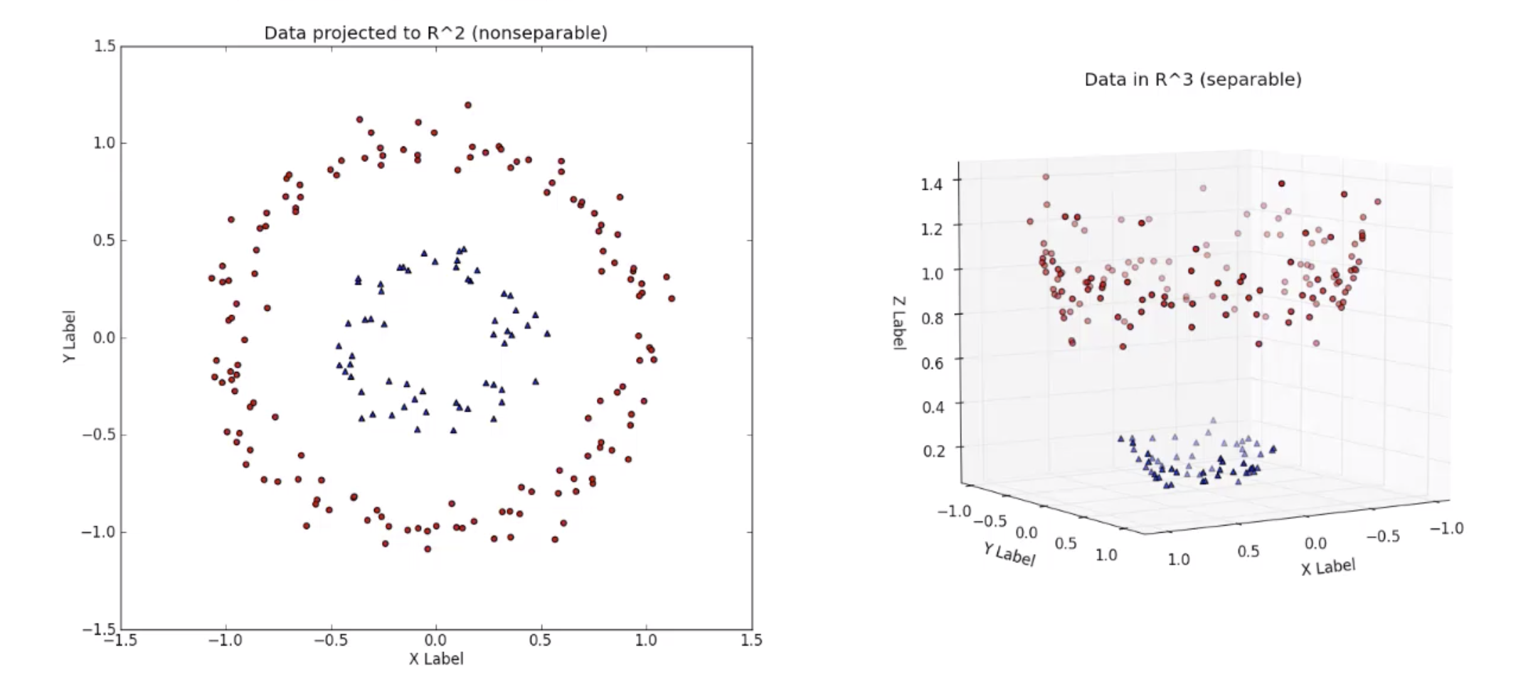
Nonlinear Hyperplane
We can expand this idea to non-linearly separable data through the “kernel trick”.

Slide 13
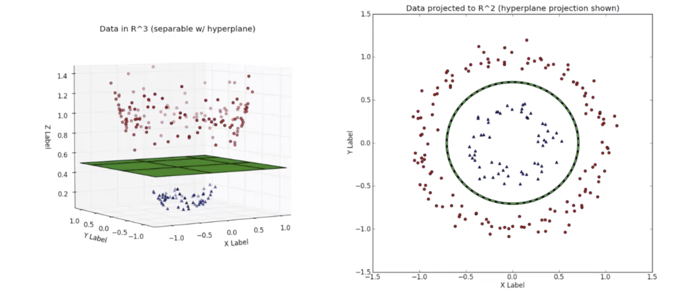
Nonlinear Hyperplane

Slide 14
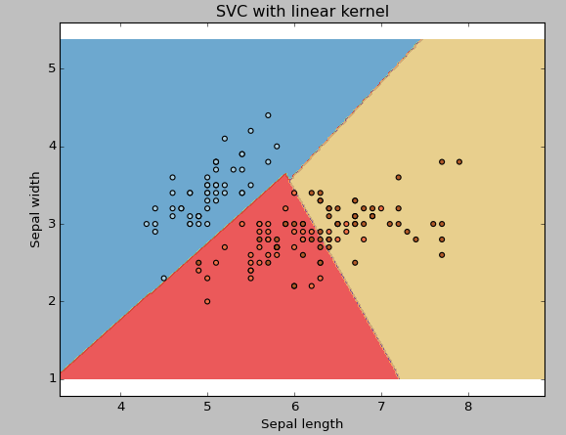
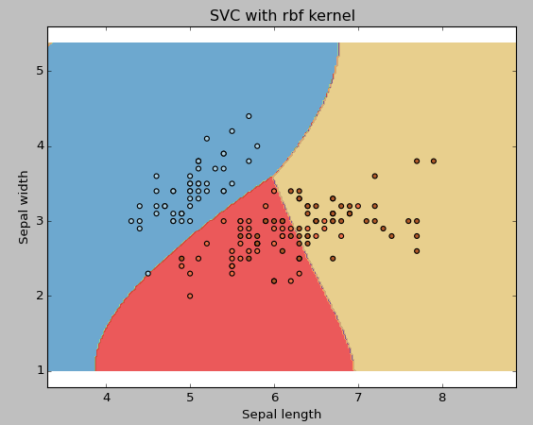
How to tune Parameters of SVM?
kernel: function for calculation:
“linear”, “rbf”,”poly” and others (default value is “rbf”). Here “rbf” and “poly” are useful for non-linear hyper-plane. The main function of the kernels is to transform the given dataset input data into the required form.
“poly”: polynomial.
“rbf”: radial basis function.
Polynomial and RBF kernels compute the separation line in the higher dimension.

Slide 15
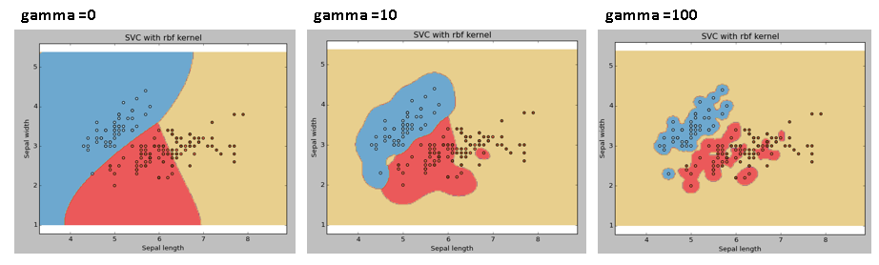
gamma: Kernel coefficient for ‘rbf’, ‘poly’ and ‘sigmoid’. Higher the value of gamma, will try to exact fit the as per training data set.

Slide 16
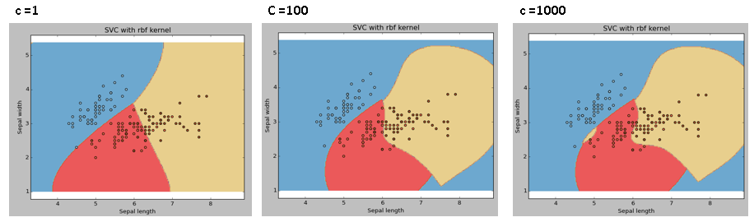
C: Penalty parameter C of the error term. It also controls the trade off between smooth decision boundary and classifying the training points correctly.

Slide 17
Pros and Cons associated with SVM
Pros:
It works really well with clear margin of separation
It is effective in high dimensional spaces.
It is effective in cases where number of dimensions is greater than the number of samples.
It uses a subset of training points in the decision function (called support vectors), so it is also memory efficient.
Cons:
It doesn’t perform well, when we have large data set because the required training time is higher
It also doesn’t perform very well, when the data set has more noise i.e. target classes are overlapping
SVM doesn’t directly provide probability estimates, these are calculated using an expensive five-fold cross-validation. It is related SVC method of Python scikit-learn library.

